Slide 1
Jeopardy
By: Riley Greene,
Chau Mai, and Steven Stewart

Slide 2
Introduction
The idea of a Jeopardy game was thought up as it is a well-known game show. It is a simple enough design to not require JavaScript and can be done using HTML, CSS, and PHP.

Slide 3
Implementation
This project revolves around the use of Session variables for the leaderboard, registration, form processing, and building the board. We tackled each one at a time.
Session variables were used to save the state of the board and keep score.
Leaderboards track the user score for each game.
Registration and form processing go hand in hand requiring username, password, and name.

Slide 4
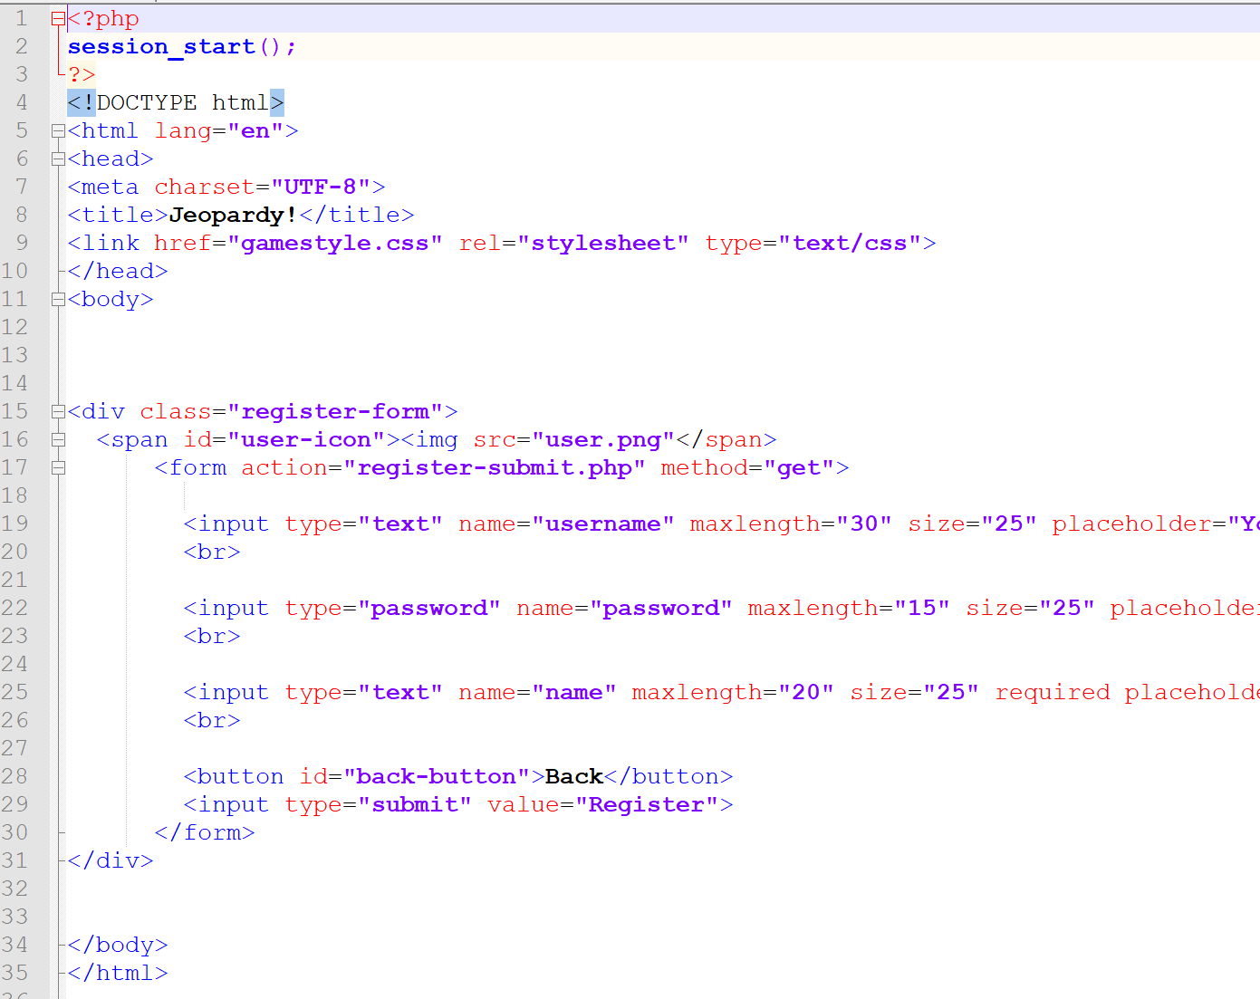
Registration is done the first time a user access the page. It takes required info and sends it to another php file through use of a form to check for validation later. It then saves the info to a text file.

Slide 5
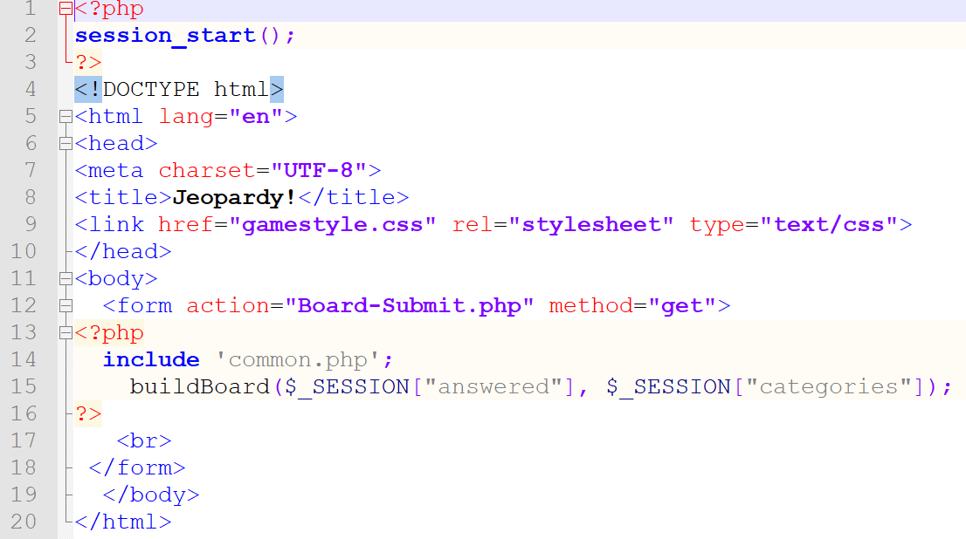
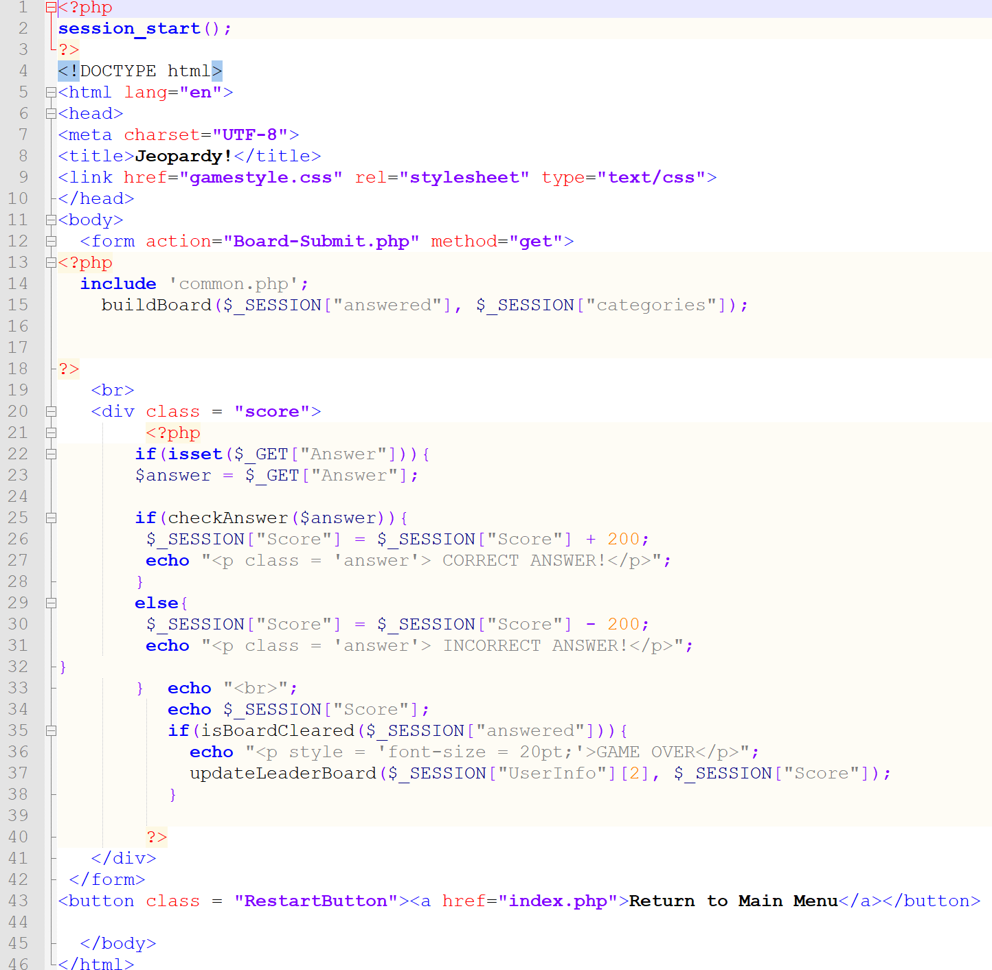
Code Snippets

Slide 6
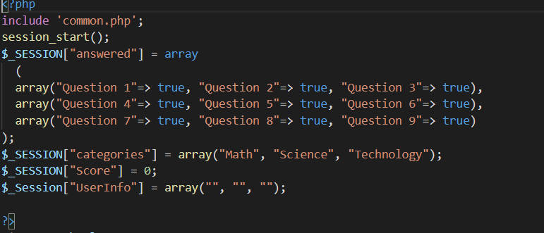
Key Features: Session variables

Slide 7
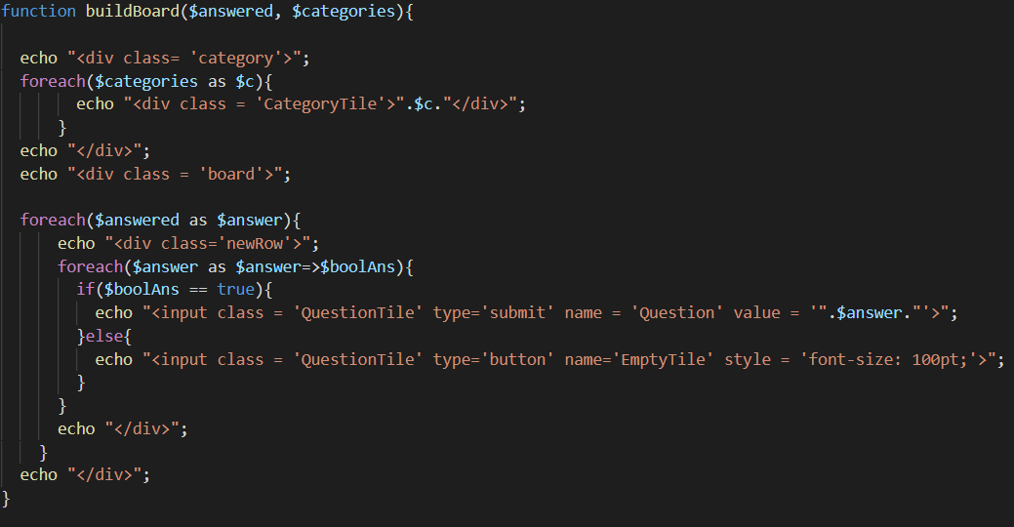
Key Features: Board building

Slide 8
How to play
The game is browser based so you must either sign up or have an account already to play.
You then sign in and can play
Answer the questions to gain points and get a high score!
Remember to answer with ‘What is’

Slide 9
Let’s Play Jeopardy!

